Slide 1


Slide 2
Speaker
Steve White
Team Leader at Young Presbyterian Church
Talks on Identity

Slide 3
Campers needed!
For campers who have finished year 6 through to people who are 21 years old.

Slide 4
Leaders needed!
Small Group Leaders
Camp Parents
Activities Team
Session (A/V)
Kids Program
And many others

Slide 5
Mentors needed!
One of the unique aspects of PY camping
A chance for more experienced Christians to have an impact on youth leaders, and help in the smooth running of camp
Would suit empty nesters / adult Christians of any age.

Slide 6
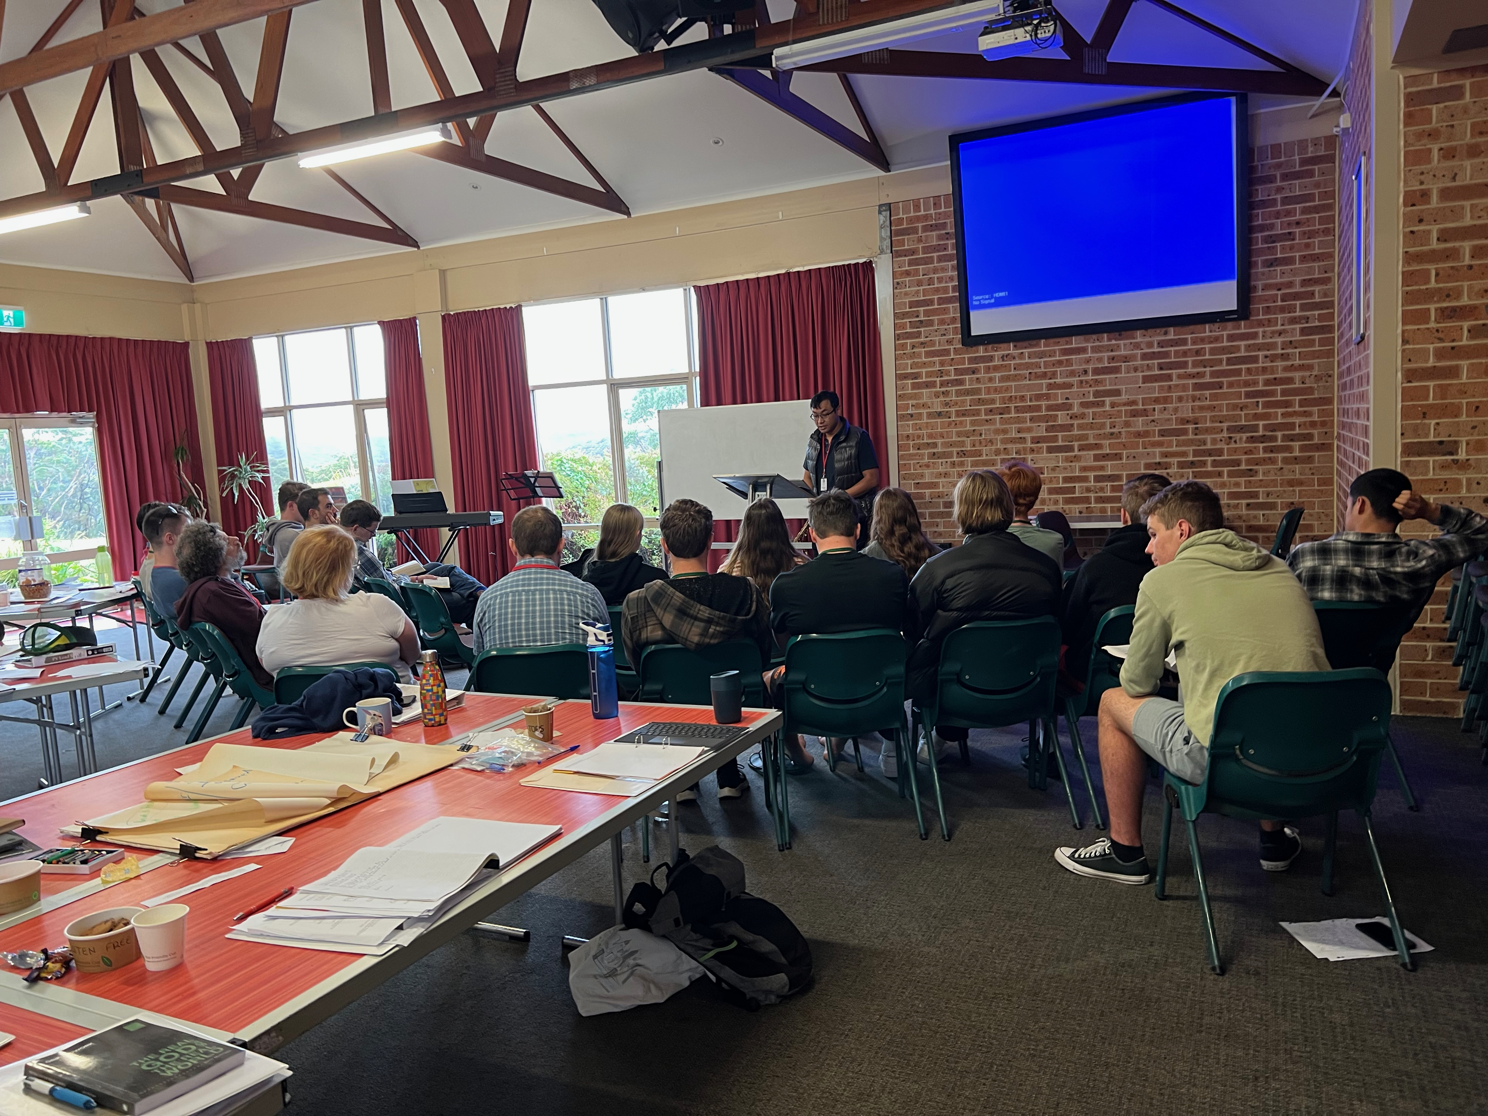

Interns
People who have finished year 12, who are in leadership roles already or have leadership potential

Slide 7
